Slide 1

Exodus Defence Force
“Saving your resources one dead bug at a time.”

Slide 2
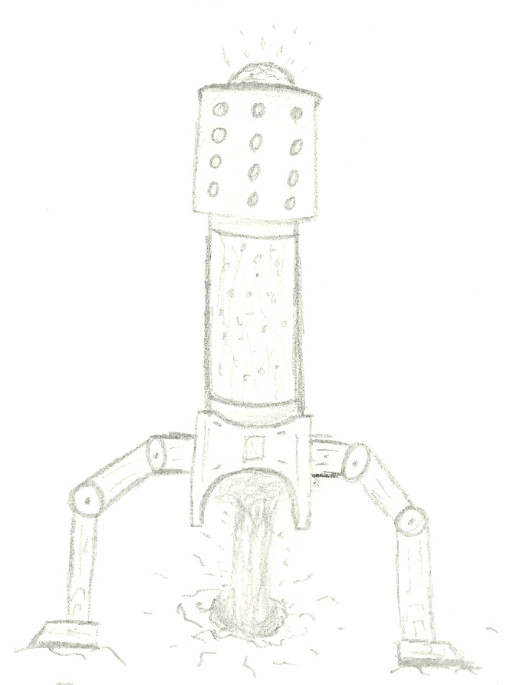
Introduction
Description
A game where you must defend your bases against waves of enemies in order to secure resources for the people of earth.
Genre
Tower defence style game.
Target Audience
Males and females from the age of 7 and up.

Slide 3

Story
Backstory
Earth has run out of natural resources and is struggling with the ever increasing population, so we took to the stars and other planets to find more resources. But now we are under attack and it is up to you to help defend our bases.
Setting
The game will be set across three different areas of a fictional planet named Exodus-21

Slide 4
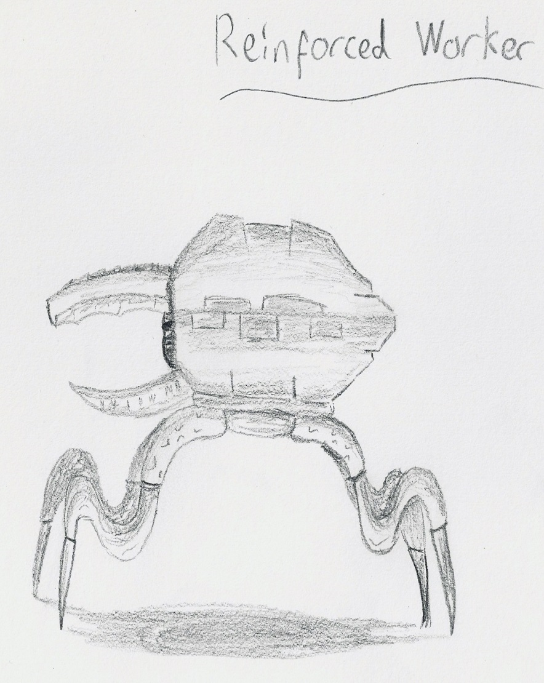
Defences & Enemies
Defences
You will have a wide range of different turrets and other defences to help you, these include laser turrets, gas mines and shotgun turrets.
Basic Enemies
Our troops on the ground have confirmed there is a large variety of enemies with each one of them being more deadly than the last. Examples of their attacks are fire spitting, crushing things under their immense size and slashing people in half.
Queen
We also have word about a queen who is growing more and more angry and could attack at anytime.

Slide 5
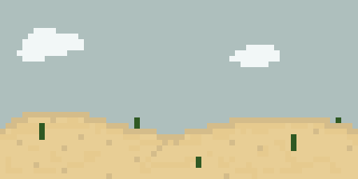
Areas
Desert
A baron wasteland filled with nothing but sand and a few oil extractors.
Grassland
A vibrant green land covered with foliage as well as settlements.
Mountains
Mountain tops covered in snow and ice which is also where our largest power plant is kept.

Slide 6
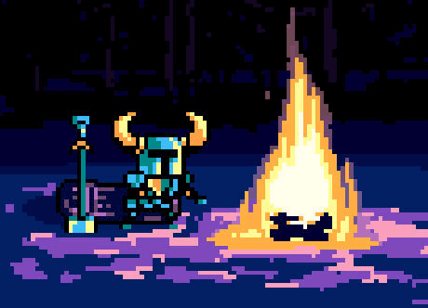
Graphic Style
Pixel Art
Not commonly used in tower defence games
Can still be used to incorporate lots of detail while providing a retro look
Look and Feel
Focusing on a more cartoon look for children but will still add detail and shading to give somewhat of a gritty realistic feeling.

Slide 7
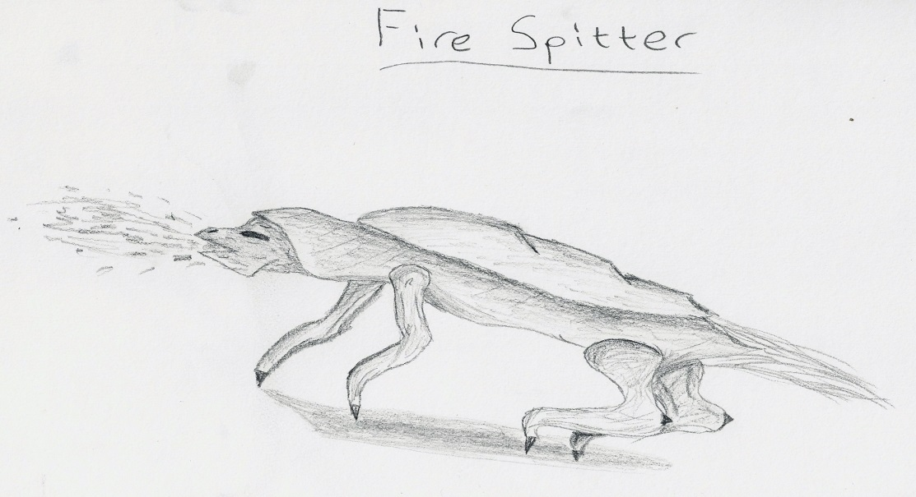
Gameplay
Mechanics
Variety of different defences and stats
Variety of enemies, attacks and stats
Swipe screen to view different grids
Shake device to remove oil from screen
Level Progression
Player must successfully stop all enemies from reaching the base, even if one enemy reaches the base the player will need to restart.

Slide 8

Audio
Audio
Using chip-tunes to go with retro setting and feel
Music will start slow but the pace will increase with the battles intensity
Sound effects for defences firing and enemies dying
Castlevania Soundtrack
Nintendo Entertainment System
Game Modes
Story mode – Player must defend various bases against the enemy attack
Survival mode – Player must survive through as many enemy waves as possible

Slide 9
Technical Requirements: Software
Unity – Game engine and development environment.
Adobe suite - These will be used to edit and manipulate the games graphics.
Pickle/Piskel - These will be used for the actual drawing of the sprites and graphics for the game.
Audacity - This software will be used to record/manipulate sound effects for the game.
Software | Price (£)
Unity Pro | 950
Adobe Suite | 638.40pa
Pickle | 16.10
Audacity | Free

Slide 10
Technical Requirements: Hardware
COMPONENT | SELECTION | AMOUNT | PRICE
CPU | i5-3570K | 2 | £161.94
CPU Cooler | Noctua NH-U12S 55.0 | 2 | £48.79
Motherboard | ASRock Z77 Extreme4 | 2 | £84.42
Memory | G.Skill Ripjaws 8GB | 2 | £62.39
Storage | Samsung 840 256GB | 2 | £114.78
Storage | WD BLACK 2TB | 2 | £89.99
Video Card | MSI GeForce GTX 760 2GB | 2 | £143
Case | Fractal Design Define R4 | 2 | £67.34
Power Supply | SeaSonic G 550W | 2 | £94.99
Operating System | Windows 8.1 | 2 | £69.23
TOTAL |  |  | £1873.74
HARDWARE | SELECTION | AMOUNT | PRICE
Monitor | Asus VS238H-P | 4 | £135.91
Mouse and Keyboard | Logitech Wireless Combo MK520 | 2 | £49.99
Tablet | Tesco Hudle 2 | 1 | £129.99
Graphics Tablet | Wacom Bamboo Pen | 1 | £39.99
TOTAL |  |  | £813.60
Overall Hardware Cost: £2687.34

Slide 11

Target Platform
Mobile Devices
Mobile phones
Tablets
Iphones
Ipads
Possible Expansion
Desktop – Similar to Plants vs Zombies
Web – Known place to play Tower Defence games
Console – Not typical found

Slide 12
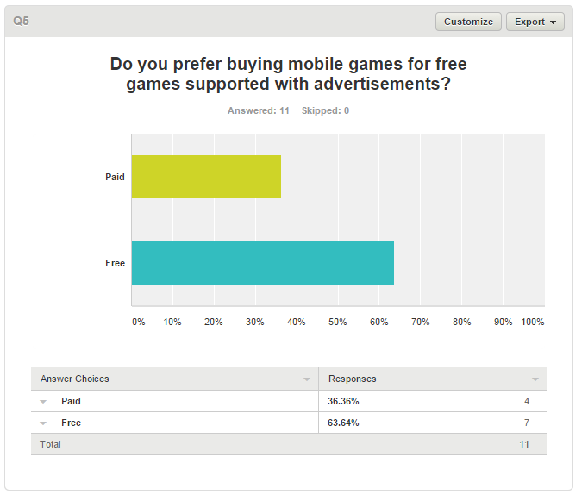
Pricing Options
Option 1: free to play with ads (possibly with micro-transactions also)
Option 2: paid app (possibly with micro-transactions also)

Slide 13
Risk Analysis
Key :( very low=1, low=2, medium=3, high=4, very high=5)
Risk | Score | Recognition | Resolution
Repetitive | Estimated Probability (3) Estimated impact (5) | If the gameplay and content could be too similar and may become repetitive | Try and add in as much content as possible and mix up the content but still keep the game simple to play
Too many paths | Estimated Probability (2) Estimated impact (4) | If we have too many paths to guard it could limit the age and skill base of players | We will need to work on a balance of challenging and fun amount of paths as to not put off players
Cluttered screen | Estimated Probability (2) Estimated impact (3) | Screens could become too messy with the amount of objects on screen and unable to see enemies/buttons | We will have to take care as to not put too many buttons/controls onscreen as well as ensure images do not overlap where they should not
Turret/Tower cost | Estimated Probability (1) Estimated impact (3) | Towers being too expensive/cheap which could make the game too easy/hard | Balance how many points player gets to build towers to go with the difficult of the game
Enemy Difficulty | Estimated Probability (2) Estimated impact (5) | Enemies could be too easy/hard to kill and could also do too much/little damage to defenses | We will definitely need players off different skill levels to play the game to ensure there is good balance
Too short | Estimated Probability (3) Estimated impact (5) | With the whole premise of the game being simple to play and learn as well as being accessible to people of all gaming skills the game could end up being too short | We are going to have to take care as not to make the game too shot but also keep in mind about the possibility.

Slide 14
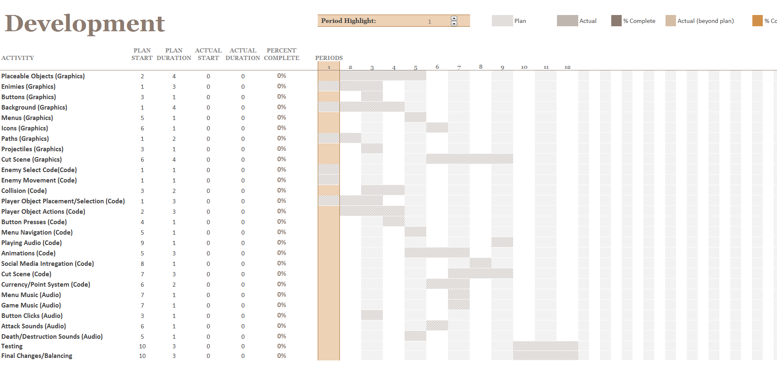
Development Plan

Slide 15
Prototype Demo

